Slide 1
The Software Architecture
of
It’s Actually Called B-
EC327: Introduction to Software Engineering
Fall 2017
Android Project
A group effort by Aleksandra Fatyga, Tanner Knabe, Evan Lang, Zoe Roth & Gordon Wallace

Slide 2
Summary
App: Budgetz
Geared towards college students, this app looks to help these students budget their money each week.
Comprised of 4 screens

Slide 3
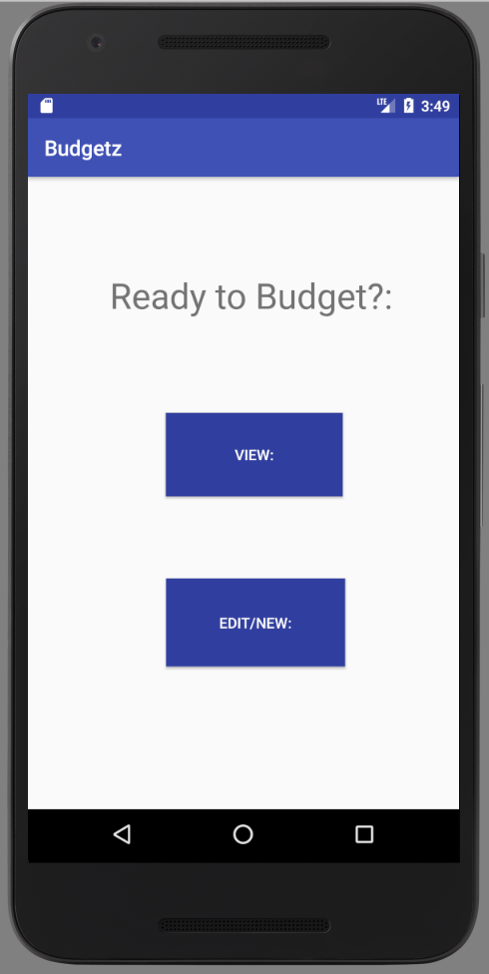
Screen 1: Welcome
App opens with the Welcome screen which asks the user if they would like to view their current budget or edit/ create a new budget.
Upon choosing one of these buttons the user is taken to a new page dependent on which button is chosen
This is implemented through a function in the welcome.java that allows for the user to change screens

Slide 4
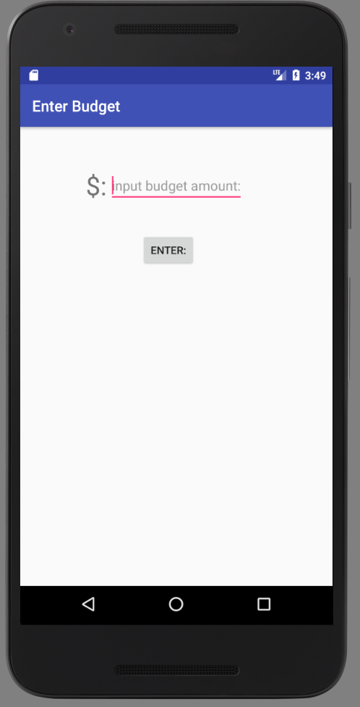
Screen 2: Enter Budget
This screen asks for the user to enter the amount of money they would like to be used for their budget
By using shared preferences, when the user enters their value it is saved so it may be used later on in the backend of the app.
Upon hitting the enter button, the screen changes to third screen to have this money divided between whatever categories the user would like

Slide 5
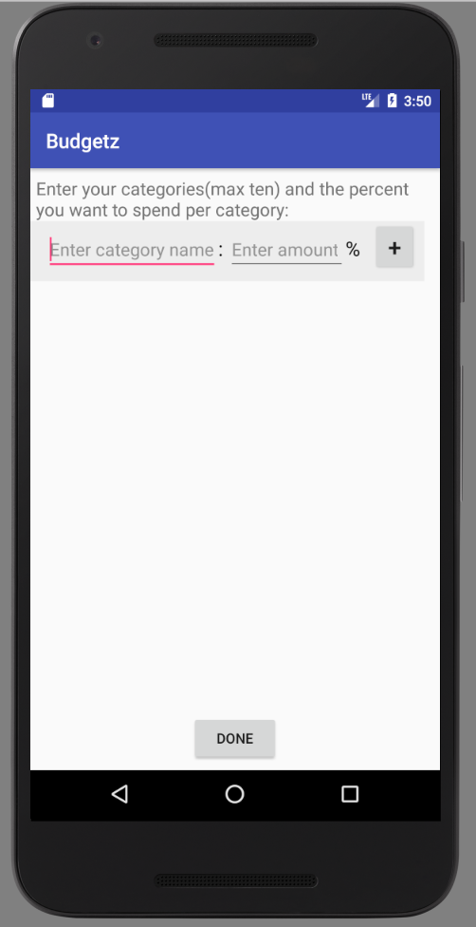
Screen 3:Set Up Budget
This screen asks the user to input a category name and the percentage of their budget they would like to dedicate it to
At the end of each line there is a plus button which creates another row in which more categories (with a max of 10) can be created
This is created through 10 categories being made and the plus button making the next one visible
These values are then saved

Slide 6
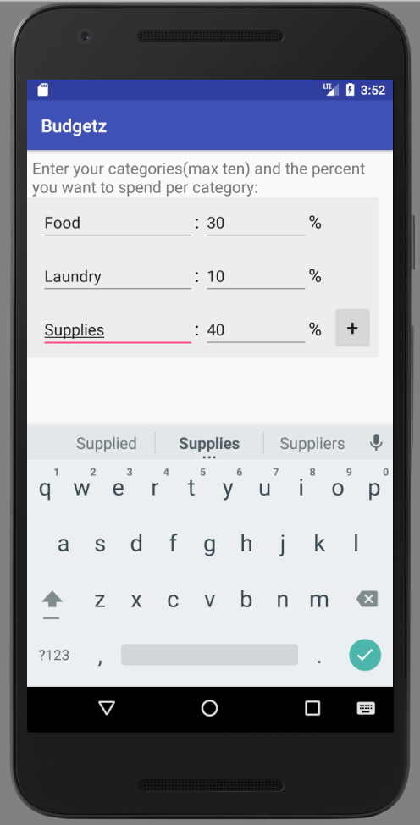
Screen 3:Set Up Budget (continued)
The names of each category are saved in an array of strings
The percentage for each category is saved in an array of strings
The name array, percent array, and number of categories are saved using shared preferences
These three values are then also pushed to the final activity

Slide 7
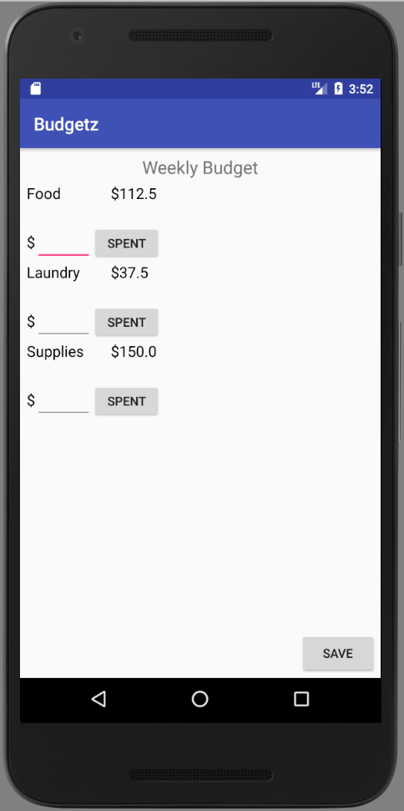
Screen 4:Main
This screen displays the amount allotted to each category and allows for money to be taken out of it so it can be tracked
There is an editText which the user can then input the money they spent and hit the Spent button which then then updates the amount left for the category

Slide 8
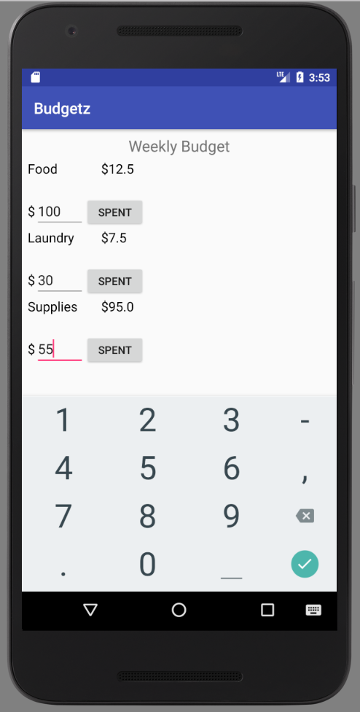
Screen 4:Main(continued)
The number of categories displayed is dependent on the number of categories entered on the third screen, or alternatively by the saved number of categories if the user is re-entering the app
Clicking the save button saves all of the current remaining values for the categories

